Slide 1
OPTICAL COMMUNICATION
Prepared By: Er. Amit Kr Tewari
Associate Professor
CS Dept.
ACEIT, Jaipur

Slide 2
Optical Communication
Optical communication systems use light to transmit information from one place to another.
Today, infrared light is being used increasingly as the carrier for information in a communication system.
The transmission medium is either free space or a special light-carrying cable called a fiber-optic cable.
Because the frequency of light is extremely high, it can accommodate very high rates of data transmission with excellent reliability

Slide 3
Optical Principles
Optical spectrum, made up of infrared, visible, and ultraviolet light.
The frequency of the optical spectrum is in the range of 3×10¹¹ to 3×10¹⁶ Hz.
The visible spectrum is from 4.3×10¹⁴ to 7.5×10¹⁴ Hz.
We rarely refer to the “frequency of light.” Light is expressed in terms of wavelength.

Slide 4
Optical Principles
Light waves are very short and usually expressed in nanometers (nm, one-billionth of a meter) or micrometers (μm, one-millionth of a meter). An older term for micrometer is micron. Visible light is in the 400- to 700-nm range or 0.4 to 0.7 μm depending upon the color of the light. Short-wavelength light is violet (400 nm) and red (700 nm) is long-wavelength light.

Slide 5
Speed of Light
The speed of light is approximately 300,000,000 m/s, or about 186,000 mi/s, in free space. These are the values normally used in calculation.
The speed of light depends upon the medium through which the light passes.

Slide 6
Physical Optics
Physical optics refers to the ways that light can be processed.
Light can be processed or manipulated in many ways.
Reflection
Refraction

Slide 7
Reflection
The simplest way of manipulating light is to reflect it. When light rays strike a reflective surface, such as a mirror, the light waves are thrown back or reflected.
By using mirrors, the direction of a light beam can be changed.
If the light ray strikes the mirror at some angle A from the normal, the reflected light ray will leave the mirror at the same angle B to the normal. This principle is known as the law of reflection.

Slide 8
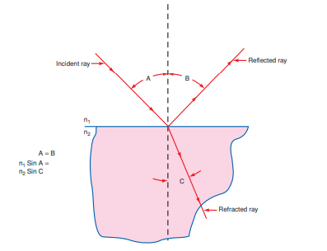

Slide 9
Refraction
The direction of the light ray can also be changed by refraction, which is the bending of a light ray that occurs when the light rays pass from one medium to another.
Refraction occurs only when light passes through transparent material such as air, water, and glass.
Refraction takes place at the point where two different substances come together. For example, where air and water come together, refraction will occur. The dividing line between the two different substances or media is known as the boundary, or interface.

Slide 10
Refraction
The refraction occurs because light travels at different speeds in different materials.
The speed of light in free space is typically much higher than the speed of light in water, glass, or other materials.
The amount of refraction of the light of a material is usually expressed in terms of the index of refraction n.
This is the ratio of the speed of light in air to the speed of light in the substance.
Naturally, the index of refraction of air is 1, simply because 1 divided by itself is 1.
The refractive index of water is approximately 1.3, and that of glass is 1.5.

Slide 11
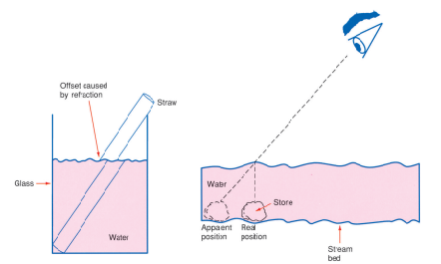
Refraction

Slide 12
Refraction
The incident ray strikes the surface at angle A to the normal but is refracted at an angle C. The relationship between the angles and indices of refractions are
n₁sin A = n₂sin C

Slide 13
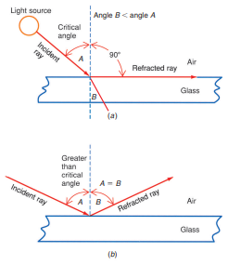
Critical angle

Slide 14
Critical angle
If the angle of incidence is increased, at some point the angle of refraction will equal 90° to the normal.
When this happens, the refracted light ray in red travels along the interface between the air and glass. In this case, the angle of incidence A is said to be the critical angle.
The critical angle value depends upon the index of refraction of the glass.

Slide 15
Total Internal Reflection
If you make the angle of incidence greater than the critical angle, the light ray will be reflected from the interface.
When this occurs, the angle of reflection B is equal to the angle of incidence A as if a real mirror were used.
This action is known as total internal reflection, which occurs only in materials in which the velocity of light is slower than that in air.
This is the basic principle that allows a fiber-optic cable to work.

Slide 16
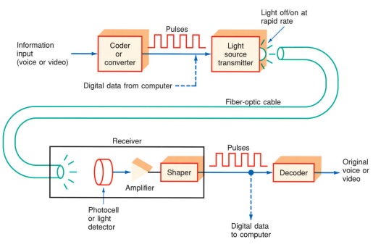
Fiber-Optic Communication System

Slide 17
The components of a fiber-optic communication system
The information signal to be transmitted may be voice, video, or computer data.
A/D converter : The first step is to convert the information to a form compatible with the communication medium, usually by converting continuous analog signals such as voice and video (TV) signals to a series of digital pulses. An A/D converter is used for this purpose.

Slide 18
The components of a fiber-optic communication system
Light Source Transmitter
These digital pulses are then used to fl ash a powerful light source off and on very rapidly.
In simple low-cost systems that transmit over short distances, the light source is usually a light-emitting diode that emits a low-intensity infrared light beam.
Infrared beams such as those used in TV remote controls are also used in transmission.

Slide 19
The components of a fiber-optic communication system
Fiber-Optic Cable: The light beam pulses are then fed into a fiber-optic cable, which can transmit them over long distances.
Receiver: At the receiving end, a light-sensitive device known as a photocell, or light detector, is used to detect the light pulses.
It converts the light pulses to an electric signal. The electrical pulses are amplified and reshaped back into digital form.

Slide 20
The components of a fiber-optic communication system
Decoder: Converted digital signal are fed to a decoder, such as a D/A converter, where the original voice or video is recovered.

Slide 21
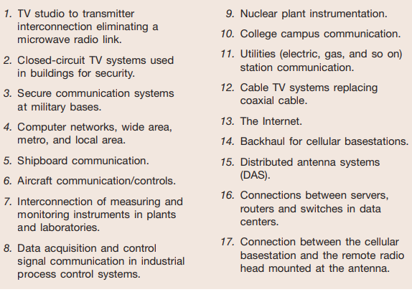
Applications of Fiber-Optic Cable

Slide 22
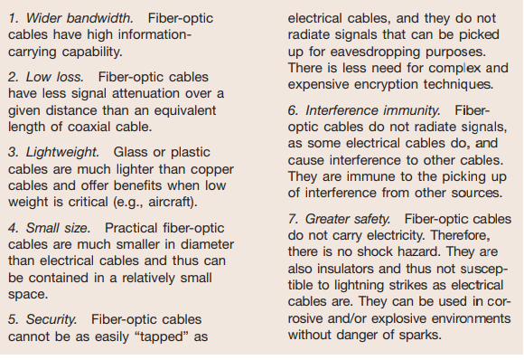
Benefits of Fiber-Optic Cables Over Conventional Electrical Cables

